Slide 1

Insights for “training” dataset
By: Jose manuel Flores flores
Tools: Python, Power bi

Slide 2
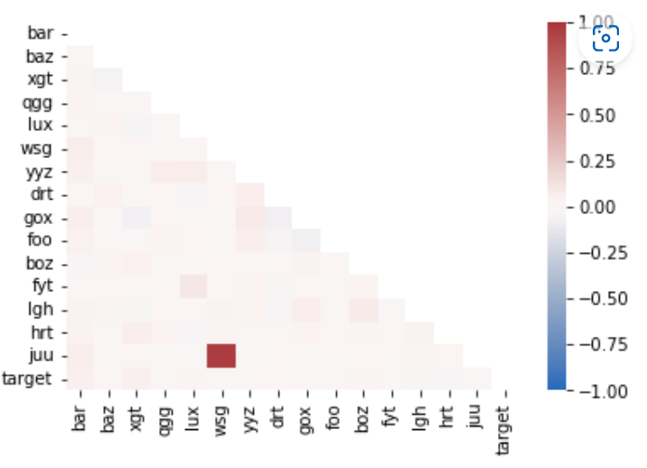
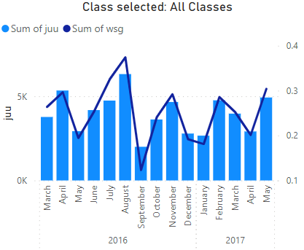
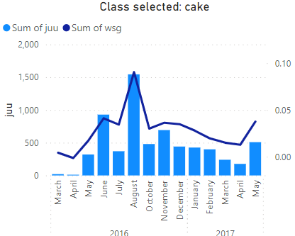
Correlation matrix
The two variables with the most relationship between them are juu and wsg with 97.4%*
1. Adding the date variable we can see that the correlation maintains over the time.
2. Also class variable keeps the relationship.
1
2
* Matrix correlation developed in python

Slide 3
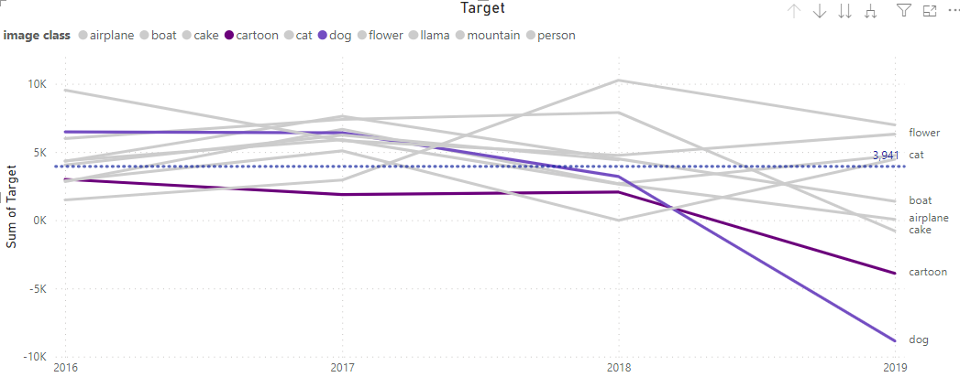
Principal Deviations
The target variable is the one I choose to represent the general behavior of dataset.
For 2019 Cartoon and Dog classes decreased more than others from de average.
The research will be focus in this 2 classes.

Slide 4
Hypothesis
The Target variable for 2019 is negative, my hypothesis is to look for a variable or combination of variables which have the same behavior over the change of year and explain this behavior the best .
All to explain why the target for this two type of classes go below zero.
On the next 2 pages are written the outcome from several attempts to find out relationship between target and the other variables.
Classes Cartoon and Dog

Slide 5
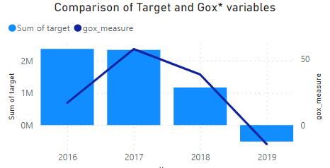
Description of Class: Dog
The Target variable for 2019 is negative, my hypothesis is to look for a variable which has the same behavior over the change of year.
The unique variable with this behavior is gox.
However analyzing the chart we can see that from 2016 to 2017 there is not a fully relationship.
*gox_measure represents gox times -1.

Slide 6
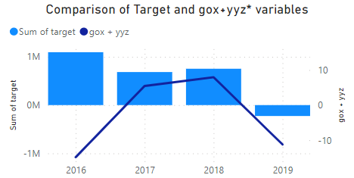
Description of Class: Cartoon
The Target variable for 2019 is negative, my hypothesis is to look for a variable which has the same behavior over the change of year.
Variables for cartoon description are the combination of gox and yyz
*gox+yyz represents gox times -1 plus yyz times -1.

Slide 7
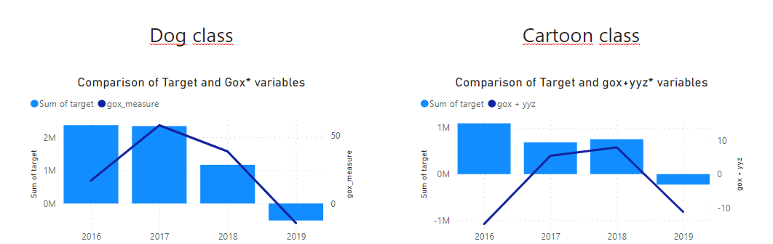
Conclusion
Gox variable is the most representative for trying to understand the behavior of the target variable over the time.
So, knowing about what means gox and yyz we can understand the target variable trend.
Find the information on the next link

